Slide 1
Project development and Marketing Strategy for US based phone company

Slide 2
Agenda
Objective
Background
Key findings
Recommendations
Appendix
Data sources
Data methodology

Slide 3
Objective
Development of features which have high utility value for the customers
Get insights from the user experience with current device
Improve our shared understanding about strategies and market share of competitor brands

Slide 4
Data preparation and cleaning
Data was cleaned for missing values and outliers
Visualized relation between different parameters using EDA
Used tableau to visualize key relationships and develop insights
Used lexical process to make word cloud
Used Naive Bayes’ to build a model

Slide 5
Background
Around 275 million Smartphone users are in United states.
Overall Sales are increasing drastically every year
There are lot of competitors brands in the market.

Slide 6
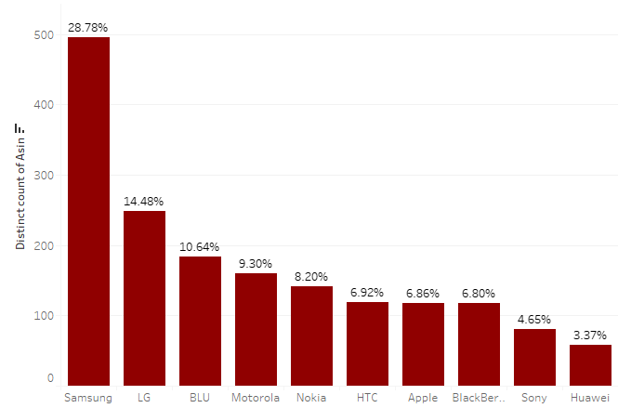
Top Manufacturer company
Samsung provide highest number of product among all the brands
Around 29% of products are provide by the Samsung brand.
LG, BLU, Motorola together provides 25% products in the market.

Slide 7
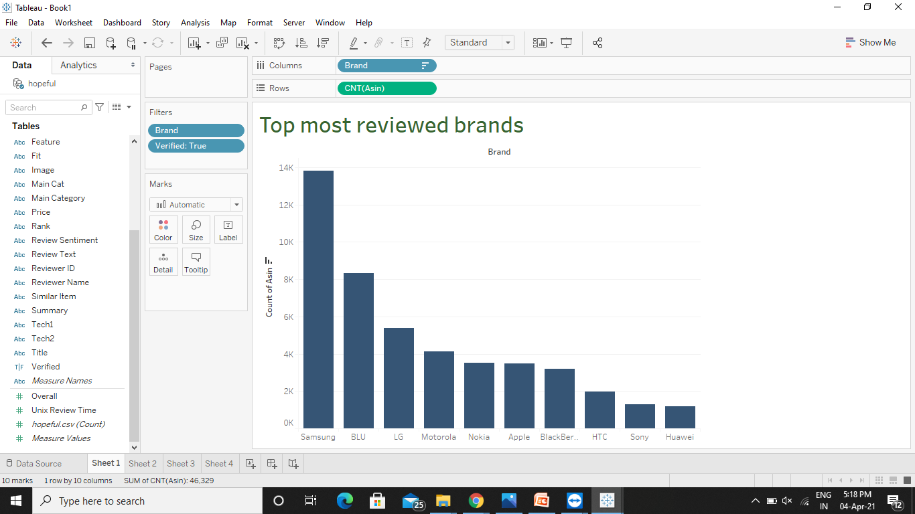
Most reviewed Brands
Samsung is top reviewed brand as they provide highest number of product in the market.

Slide 8
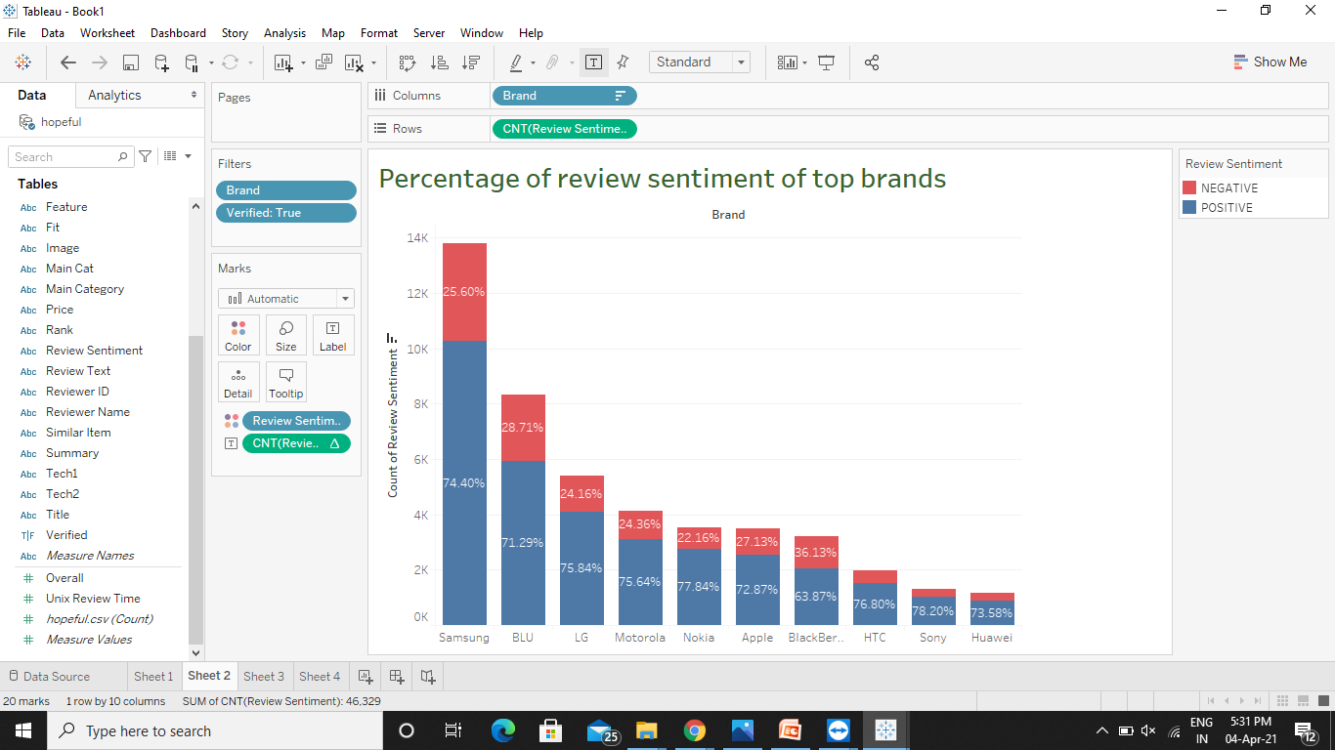

Most loved Brands according to review sentiment
Almost every top 10 brands have greater than 70% positive review.
Sony and Nokia brand has highest number of positive review around 78%.
Samsung with highest number of review have 74% positive review.

Slide 9
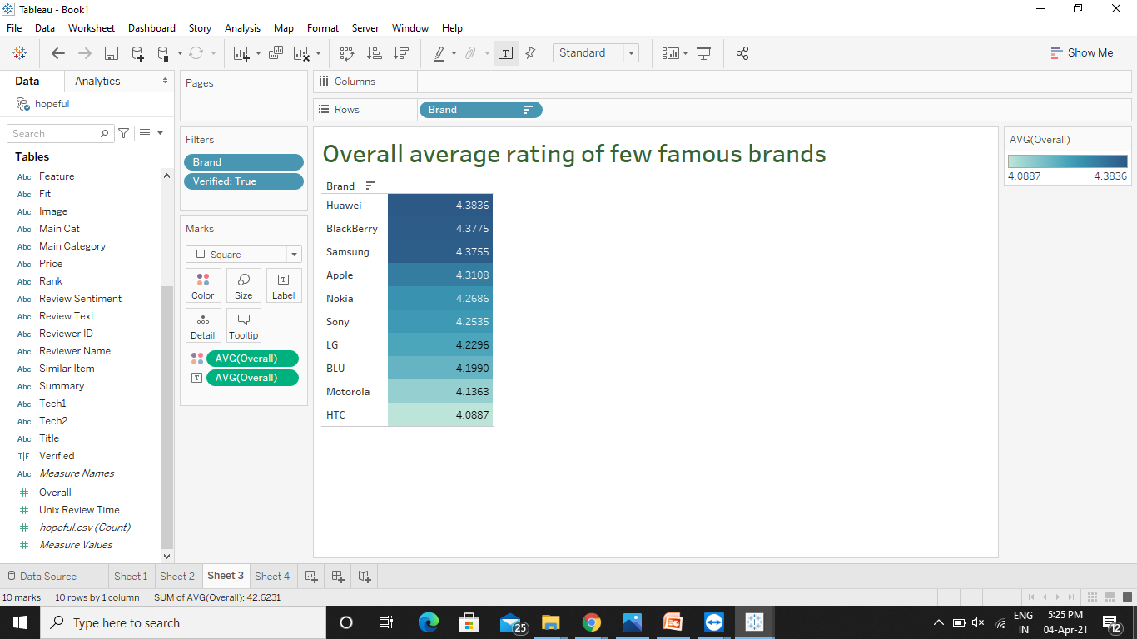
Overall average rating of few famous brands
According to overall average rating Huawei has highest rating of 4.38.
All top 10 famous brand has average rating greater than 4.

Slide 10
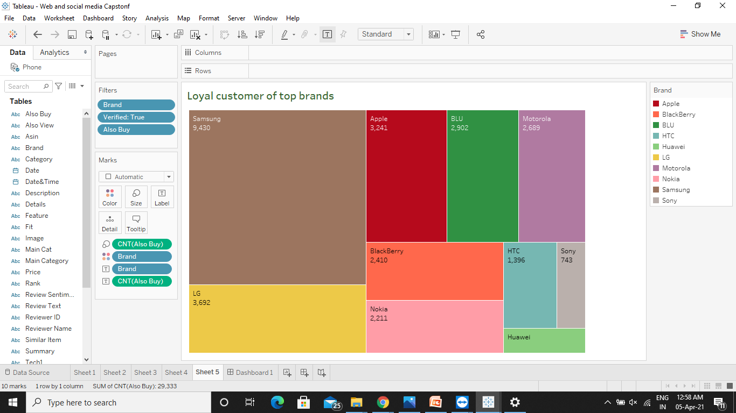
Loyal customers of top brands
Samsung users are more likely to buy other brands products also.

Slide 11
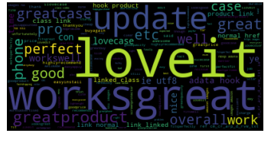
Most used words in review
Update, love it, works great are few highly occurred words in review text.

Slide 12
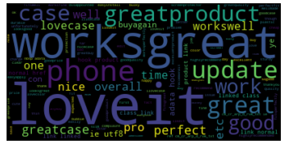
Positive word cloud
Works great, Update, love it, great product, buy again, work well are few highly occurred words in positive review text.
Update, pro, time, case are few phone related words that are highly occurred in the positive sentiments.

Slide 13
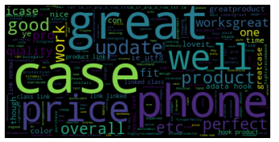
Negative word cloud
Case, price, phone, update, overall are few highly occurred words in negative review text.
Fit, update, price are some important word related to phone in negative review to look for

Slide 14
Confusion Matrix of model
Accuracy – 67%
Sensitivity – 66%
Specificity – 73%

Slide 15
Recommendation
Company must target and closely observe the strategies of some top brands in the market.
Company must target the variety of products as Samsung is top manufacturer in the market and popular among the customer.
Company must target the Samsung, LG, Blackberry users as they are less loyal towards their brand and they are more likely to shift towards new brands.
Price and Update are two main property that is widely use in review text. Company should fix the price range accordingly and provides security updates regularly.

Slide 16
Appendix – Data sources
Here is a snapshot of our data dictionary.
Phone Metadata – This data contains the product information and is independent of consumer/reviewer activity and includes description, price, sales-rank, brand info, and co-purchasing links etc.
Phone dataset – This data contains consumer activity like review text, reviewer ID, reviewer Name, sentiment.
We used the following data sources:
Amazon review data for different cell phones and accessories that were purchased between the years 1996-2018.

Slide 17
Appendix – Data methodology
We conducted a thorough analysis of Amazon phone review dataset. The process included:
Cleaning the data set using python
Visualize data using EDA
Used lexical process to form word cloud for positive and negative review
Used Naive Bayes’ for model building

Slide 18
Thank you
By -Archana

